Slide 1
Design & Simulation of a High-Gain EMG Amplifier
Mid Evaluation Presentation
Dept. of Electronics Engineering
Prof. Sanjeev Kumar Raghuwanshi
Vinay Kumar (22JE1073)
Yarabolu Rishitha (22JE1095)

Slide 2
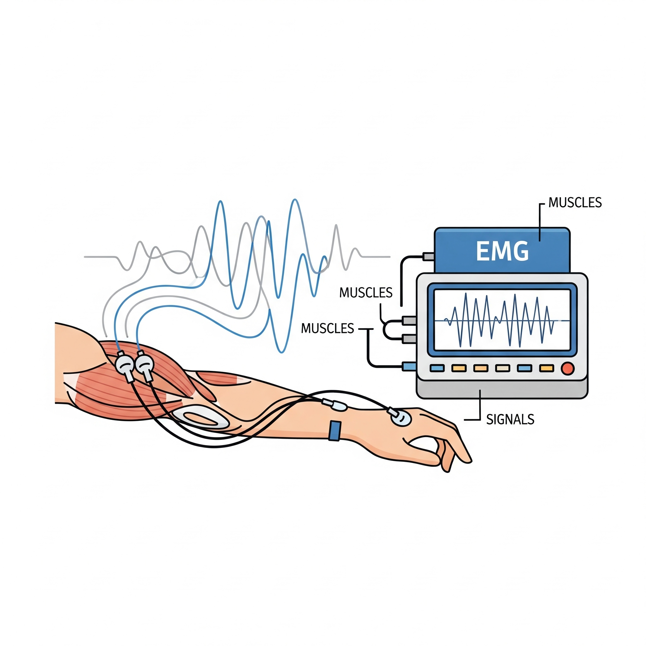
Presentation Outline
Introduction: What is EMG?
The Challenge: Signal vs. Noise
Design Goals: General Objectives
Circuit Design: A 3-Stage Solution
Component Analysis: In-Amp, HPF, and LPF
Simulation: Building Realistic Test Signals
Results: Input vs. Final Output
Analysis: Simulation vs. Reality

Slide 3
What is EMG and What Does It Do?
What is it?
"EMG" (Electromyography) is a technique used to record the electrical activity produced by skeletal muscles.
What does it do?
EMG is widely used for:
- Medical diagnosis of nerve and muscle disorders.
- Controlling advanced prosthetic limbs.
- Analyzing performance in sports and rehabilitation.
The Signal: When a muscle contracts, it generates tiny electrical signals. The EMG signal is the sum of thousands of these, characterized by a low amplitude (microvolt to millivolt range) and a specific frequency band (typically 10-500Hz).

Slide 4



The Challenge: Signal vs. Noise
The Weak Signal
The Overwhelming Noise
The raw signal from a muscle signal is incredibly small, often in the 0.1-10 mV range. Our test signal is 1mV.
The human body acts as an antenna, picking up electrical noise (like 50/60 Hz mains hum) that can be many orders of magnitude stronger than the biological signal

Slide 5
Design Goals for an EMG Amplifier
High Amplification (Gain)
Provide very high gain (typically 500x-2000x) to boost the weak microvolt/millivolt signal into a usable volt-level range.
High Noise Rejection (CMRR)
Aggressively reject strong common-mode noise (like 50/60Hz mains hum) to achieve a high Common-Mode Rejection Ratio.
Selective Filtering (Bandwidth)
Isolate the useful 10-500Hz EMG band by removing low-frequency motion artifacts and high-frequency electronic noise.

Slide 6
Standard EMG Amplifier Design
Stage 2: High-Pass
Final Output
Removes low-frequency motion artifacts and DC drift.
A clean, amplified, and filtered signal.
Stage 1: In-Amp
Stage 3: Low-Pass
Provides high gain & rejects common-mode noise (e.g., 50/60Hz hum).
Removes high-frequency noise (anti-aliasing).

Slide 7
Key Components in the Design
Active & Passive Components
Simulation Sources
Op-Amp (LM324): The "workhorse" of the circuit. Used to build all three active stages (In-Amp, HPF, LPF).
EMG Signal (B5): A behavioral source (bv) creating a 1mV, 150Hz *bursting* signal to simulate a muscle flex.
Resistors:
- Rg1 (200Ω): Sets the In-Amp gain to 221x.
- R_a1, R_b1 (82kΩ): Set the HPF cutoff.
- R_c1, R_d1 (33kΩ): Set the LPF cutoff.
Noise Signal (B4): A behavioral source (bv) creating a "dirty" 1V, 50Hz signal with harmonics and drift.
Capacitors:
- C1, C2 (100nF): Block DC and set the HPF
cutoff.
- C3, C4 (10nF): Remove HF noise and set
the LPF cutoff.
Test Mixers (B1, B2): Behavioral sources that combine the "good" signal and "bad" noise to create the realistic ‘IN+’ and ‘IN-’ inputs.

Slide 8
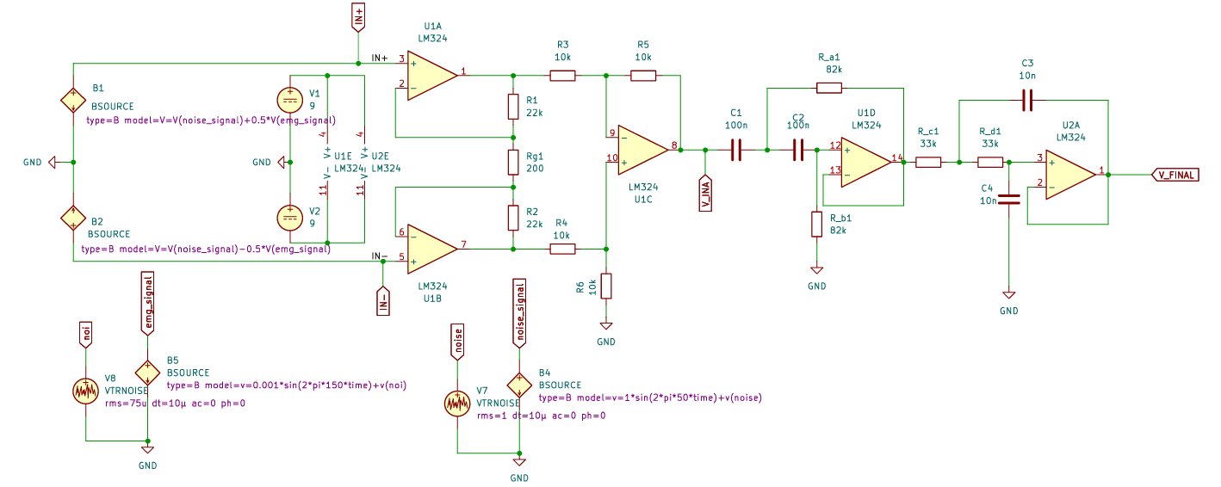
Full Circuit Schematic

Slide 9
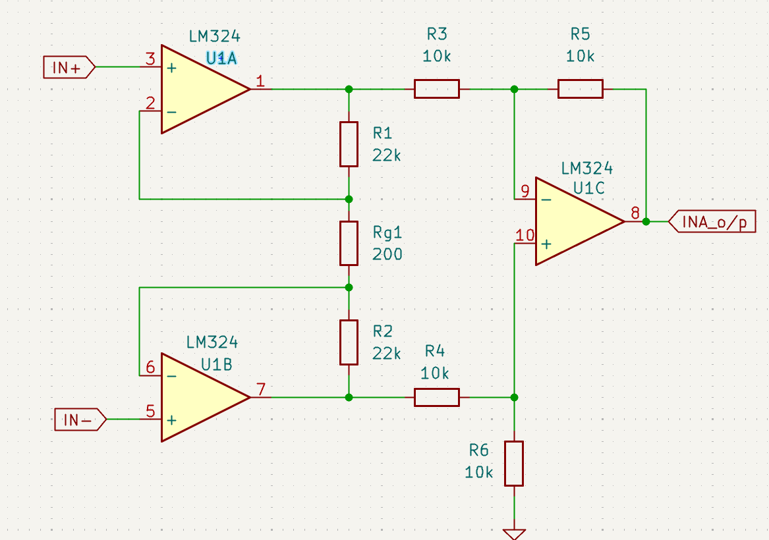

Stage 1: The Instrumentation Amplifier
Theory & Calculation
The In-Amp is the heart of the circuit, built from three op-amps to solve two problems at once:
1. High Input Impedance: The inputs connect to op-amps (U1A, U1B), which "listen" to the skin's voltage without drawing significant current. This is vital as the weak 1mV signal would collapse if "loaded" down.
2. High CMRR (Common-Mode Rejection Ratio): This is the In-Amp's most important ability. It measures how well the circuit rejects the "common" 1V 50Hz noise while amplifying the "differential" 1mV muscle signal.
G = 1 + (R1 + R2) / Rg1
G = 1 + (22k + 22k) / 200Ω
G = 221

Slide 10
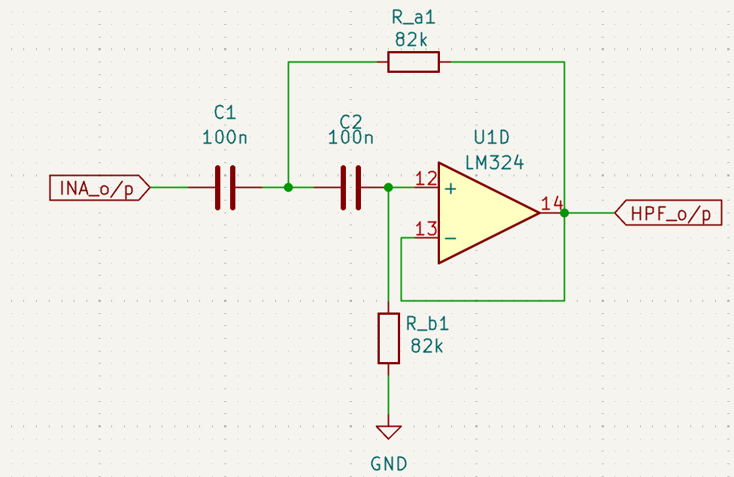
Stage 2: The High-Pass Filter (HPF)
Theory & Calculation
This stage is 2nd-Order Sallen-Key active High Pass filter, which serves two critical functions:
Steep Roll-off: Being 2nd-Order (using two capacitors), it has a steep -40dB/decade roll-off. This is twice as sharp as a 1st-order filter and is crucial for aggressively removing the strong, low-frequency "motion artifact" noise (from breathing or cable movement) that is below our 19.4Hz cutoff.
Active Buffering: The op-amp (U1D) acts as a buffer, isolating this HPF from the LPF stage that follows. This prevents the stages from interfering with each other and ensures our calculated cutoff frequency remains accurate.
The cutoff frequency (f_c ) is set by R_a1, R_b1, C1, and C2.
f_c = 1 / (2πRC)
f_c = 1 / (2π * 82kΩ * 100nF)
f_c = 19.4 Hz

Slide 11
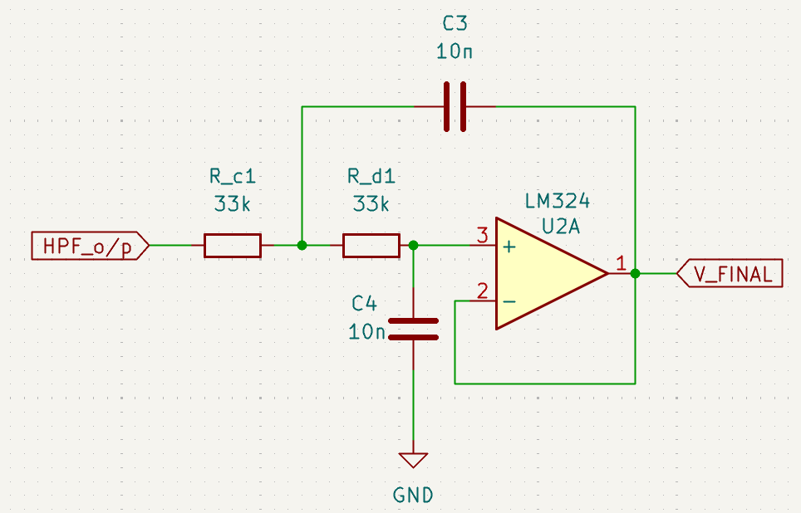
Stage 3: The Low-Pass Filter (LPF)
Theory & Calculation
This final stage is another 2nd-Order Sallen-Key active Low Pass filter, which serves two critical functions:
High-Frequency Noise Removal: Just like the HPF, its 2nd-Order design provides a steep -40dB/decade roll-off. This effectively removes high-frequency noise (e.g., from other electronics) that is above our 482 Hz cutoff, "cleaning up" the signal.
Anti-Aliasing: By guaranteeing that no signals above 482 Hz get through, this LPF acts as an anti-aliasing filter. This is a critical step to prevent signal distortion (aliasing) if the output is later sampled by a digital-to-analog converter (ADC) for a microcontroller, ensuring data integrity.
The cutoff frequency (f_c) is set by R_c1, R_d1, C3, and C4.
f_c = 1 / (2πRC)
f_c = 1 / (2π * 33kΩ * 10nF)
f_c = 482 Hz

Slide 12
Total System Specifications
Parameter | Value | Description
Total Gain | ~221x | Set by ‘Rg1 = 200Ω’ in the In-Amp stage.
Bandwidth | 19.4 Hz – 482 Hz | This is the "passband" for our EMG signal.
Input Signal | 1mV @ 150 Hz | Sits perfectly inside the passband.
Noise Signal | 1V @ 50 Hz (+white noise) | Rejected by the In-Amp (CMRR).
Expected Output | 1mV * 221 = 221mV | A clean, amplified version of the input signal.

Slide 13




Simulation: Our Realistic Test Signals
The Test
(B1, B2)
EMG Signal (B5)
Noise Signal (B4)
We created a realistic bursting signal: a 1mV, 150 Hz sine wave that turns on and off to simulate a muscle flexing and relaxing.
We built a "dirty" noise signal: a 1V, 50Hz hum combined with White Noise for a worst-case test.
These sources mix the "good" and "bad" signals, creating the final ‘IN+’ and ‘IN-’ inputs that are fed to our amplifier.

Slide 14


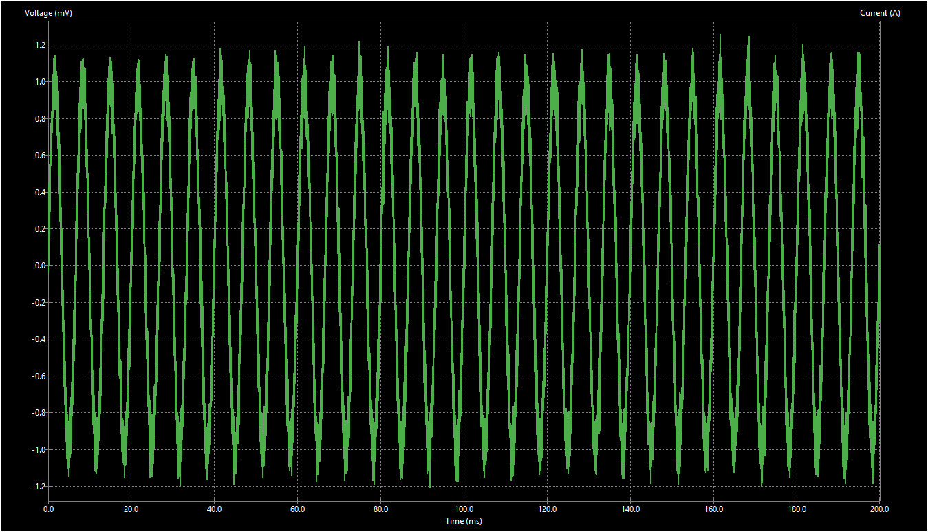
Simulation: EMG Signal
This is 1mV muscle signal with 150Hz frequency

Slide 15
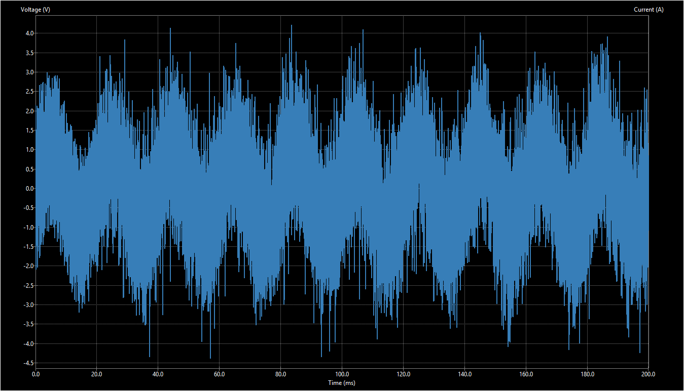
Simulation: The Input
This is what the amplifier sees at ‘IN+’. The tiny 1mV muscle signal is completely invisible, buried inside the 1V 50Hz noise.

Slide 16
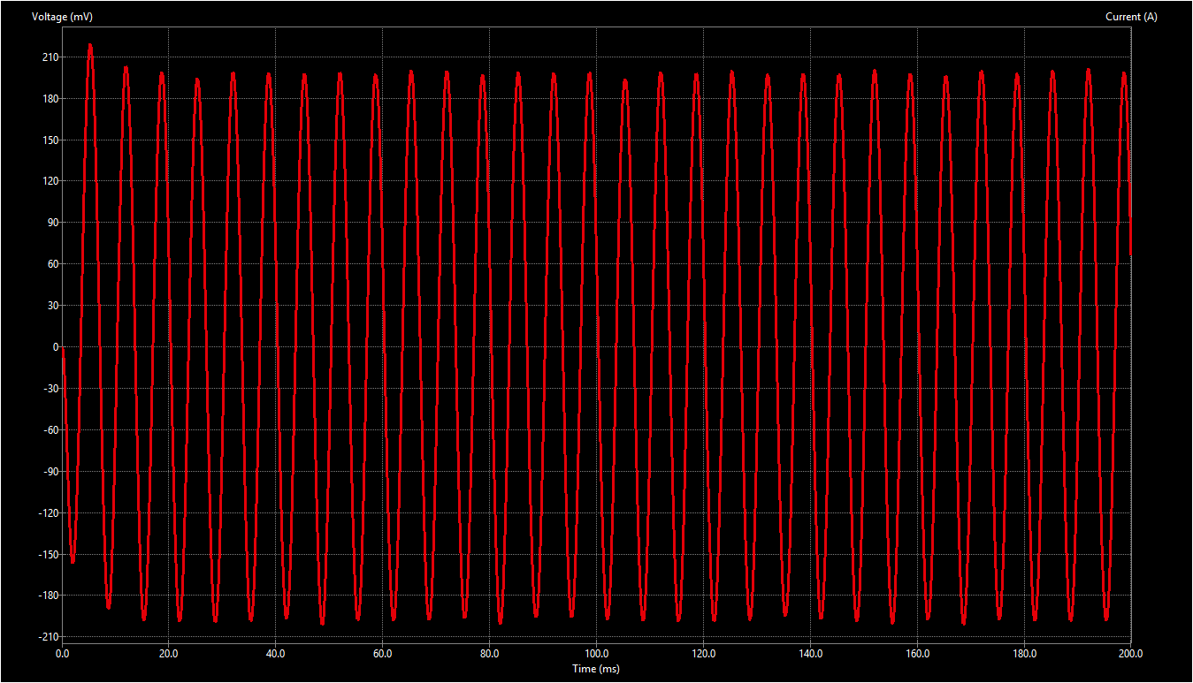
Simulation: The Output
Success! The final output at ‘V_FINAL’ shows the clean, amplified 150 Hz signal (at ~220 mV).
The 1V noise has been completely filtered out.

Slide 17
Analysis: Ideal Simulation vs. Real-World Signals
Our Ideal Simulation Model
Real-World Considerations
Simplified Signal: Uses a predictable 1mV,150 Hz sine wave to represent the signal's dominant frequency.
Stochastic Signal: The real EMG signal is non-periodic (stochastic), with its energy spread across a wide frequency band.
Controlled Noise: Uses a known 1V, 50Hz wave (with harmonics) to test and validate noise rejection (CMRR).
Complex Noise Floor: Reality includes thermal noise, electrode "pop" noise, and crosstalk from nearby muscles.
Perfect Components: Assumes ideal op-amps and perfect, exact values for all resistors and capacitors.
Component Tolerances: Real components have tolerances (1-5%), and op-amps have internal noise and offset voltages.

Slide 18
References
Instrumentation Amplifier Design:
Chowdhury, M. Z. A., & Roy, D. P. "Circuit Design and Analysis of an Electromyography (EMG) Signal Acquisition System." (IEEE).
(This paper provided the core 3-op-amp instrumentation amplifier design used in this project.)
EMG Signal Characteristics (Amplitude):
De Luca, C. J. (1997). "The use of surface electromyography in biomechanics." *Journal of Applied Biomechanics*.
(Validates our 1mV test signal as a realistic amplitude for EMG.)
EMG Filtering Standards (Bandwidth):
Merletti, R., & Di Torino, P. (1999). "Standards for reporting EMG data." *Journal of Electromyography and Kinesiology*.
(Provides the basis for our 19.4Hz – 482 Hz filter bandwidth, which aligns with the 10-500Hz standard.)

Slide 19
Future Work: Hardware Implementation
PCB Design: The next step is to move from the schematic to a physical Printed Circuit Board (PCB) using KiCad PCB editor. This involves component placement and routing traces.
Digital Integration: Connect the final analog output to an Analog-to-Digital Converter (ADC) of a microcontroller (like an Arduino or ESP32).
Signal Processing: Once digitized, the signal can be processed to control prosthetics, analyze athletic performance.
Prototyping: Soldering the components onto the PCB and addressing real-world hardware challenges, such as creating a proper RF-shielded enclosure.
Real-Signal Testing: Test the physical board using Ag/AgCl electrodes on a human subject to validate its performance outside of simulation.

Slide 20
Thank You
Questions?

